Slide 1

WATER AND SANITATION SERVICES NORMS AND STANDARDS: FOCUS ON SANITATION
Presented by:
Name Surname : Ms. Iris Mathye
Designation : Director
Chief Directorate: : Sanitation Services Support
Date : 16 May 2024
PRESENTATION TITLE
Presented by: Name Surname
Designation: Director
Directorate: Communication Services
Date: 15 April 2019

Slide 2
PRESENTATION OUTLINE
Introduction
Updates on the National Faecal sludge Management Strategy
Transition from sanitation linear economy to circular economy
Proposed sanitation norms and standards
Sanitation issues covered in the draft Norms and Standards
Conclusion

Slide 3
INTRODUCTION
Purpose:
  Make AMPS aware of the Norms and Standards issues related to on-site sanitation.
  Help prepare for compliance with the Norms and Standards
The Department of Water and Sanitation (DWS) gazetted the revised Water and Sanitation Services Norms and Standards for public consultation in January 2024, in line with Section 9 of the Water Services Act. Comments closed on 05 April 2024.
Current regulation relating to compulsory national standards and measures to conserve water was published in 2001.
In 2017 these standards had been reviewed and published for comments.
There were numerous legal concerns raised by stakeholders and such concerns were found to be material and significant.
Draft revised Norms and Standards incorporated among others:
  Sanitation issues along the sanitation service chain in line with SDG 6.2 requirements of ensuring safely managed sanitation.
  Emerging issues from the National Faecal Sludge Management Strategy.
DWS regulates Water Services Authorities who should in turn regulate locally through by-laws.

Slide 4
UPDATES ON NATIONAL FAECAL SLUDGE MANAGEMENT STRATEGY
The Minister of Water and Sanitation approved the National Faecal Sludge Management (FSM) Strategy in October 2023.
  Engagements with AMPS helped shape the Strategy
The need to promote reuse of faecal and waste water sludge was identified as one of the key solutions for faecal sludge management which has the opportunity to generate economic opportunities.
DWS working with UKZN to develop Financial Mechanisms and Economic Models Guidelines which is an action from the Strategy to guide the sector towards circular economy and realisation of economic opportunities in sludge.
Private sector plays a key role in sludge beneficial use and could contribute towards realisation of circular economy and clean environment

Slide 5

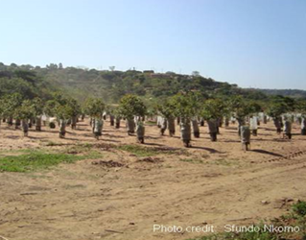
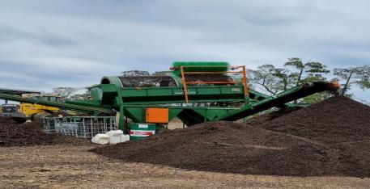

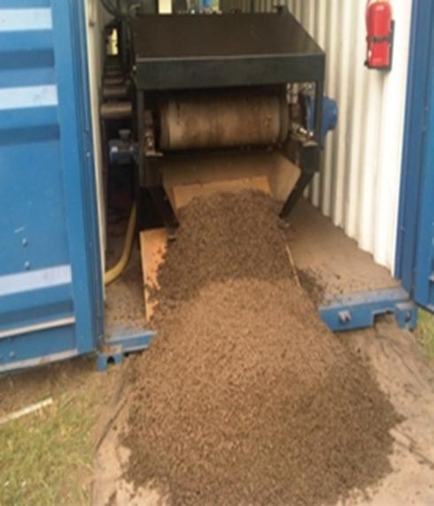
TRANSITION FROM SANITATION LINEAR ECONOMY TO CIRCULAR ECONOMY
Faecal and wastewater sludge have a potential to create jobs and economic opportunities.
Linear Economy
Waste Generation to Disposal
Plants
Capture & Containment
Treatment
Safe Reuse
Emptying & Transportation
Circular Economy
Waste Generation to reuse and recycle
Sludge as fertiliser for agriculture
Safe Disposal
Sludge used in construction material
Sludge as soil conditioner

Slide 6
SANITATION ISSUES COVERED IN THE PROPOSED SANITATION NORMS AND STANDARDS
Interim sanitation service
A Water Services Authority is responsible for the capital, operation, maintenance and refurbishment actions and cost pertaining to interim sanitation services including the management of faecal sludge in the entire sanitation value chain
A Water Services Authority and / or any Water Services Provider are prohibited from providing and / or making use of the bucket toilet systems to communities in both formal and informal settlements.
A Water Services Authority through its Environmental Health Practitioners is responsible for promoting health and hygiene awareness and for ensuring an environmentally safe approach to sanitation, and for monitoring the impact of sanitation processes on the environment – including awareness to parents and caregivers regarding safe disposal of infant faeces
Definitions for interim and basic sanitation standards
Basic sanitation service means the provision of a basic sanitation facility which is environmentally sustainable, easily accessible to a household and a consumer, the sustainable operation and maintenance of the facility, including the safe removal of human waste, greywater and wastewater from the premises where this is appropriate and necessary, and communication and local monitoring of good sanitation, hygiene and related practices
Interim sanitation services means an interim measure to provide sanitation services with privacy to the user, that is safe, readily accessible and within close walking distance and provides for the safe disposal of human waste, including hygiene and end-user education

Slide 7
PROPOSED INTERIM SANITATION SERVICES STANDARDS
Interim sanitation service
A Water Services Authority is responsible for the capital, operation, maintenance and refurbishment actions and cost pertaining to interim sanitation services including the management of faecal sludge along the entire sanitation value chain.
A Water Services Authority and / or any Water Services Provider are prohibited from providing and / or making use of the bucket toilet systems to communities in both formal and informal settlements.

Slide 8
PROPOSED INTERIM SANITATION SERVICES STANDARD (2)
Interim sanitation services must provide at least the following:
(a) Communal and shared facilities in accordance with the table below:
(b) Water for washing hands must be provided.
Toilets must include provision for appropriate disposal of menstrual materials (waste bins with lid that are emptied regularly).
Where containments/ tanks/ pits are treated chemically or biologically to prolong use and proper functioning, such chemical or biological agents must not be harmful to the health of users, water resources or the environment.
All portable toilets and mobile toilets must be emptied every third day.
Type | Toilet seat | Urinal Units | Hand washing
Communal toilet | 1 seat per 50 users | 1 unit per 100 users | 1 basin per 10 toilet seats
Shared toilets | 1 seat per 20 users | 1 unit per 50 users | 1 basin per 4 toilet seats

Slide 9
PROPOSED BASIC SANITATION STANDARD
Interim sanitation service
A Water Services Authority is responsible for the capital, operation, maintenance and refurbishment actions and cost pertaining to interim sanitation services including the management of faecal sludge in the entire sanitation value chain
A Water Services Authority and / or any Water Services Provider are prohibited from providing and / or making use of the bucket toilet systems to communities in both formal and informal settlements.
A Water Services Authority through its Environmental Health Practitioners is responsible for promoting health and hygiene awareness and for ensuring an environmentally safe approach to sanitation, and for monitoring the impact of sanitation processes on the environment – including awareness to parents and caregivers regarding safe disposal of infant faeces
A Water Services Institution must ensure that human excreta and wastewater are safely contained at all times, throughout the sanitation service chain.
Faecal sludge management must be an integral part of the sanitation service.
The infrastructure, and its maintenance as well as safe disposal of any waste must be carried out on a regular basis, as frequent as necessary to maintain hygiene, in a safe and acceptable manner by the Water Service Institution.

Slide 10
PROPOSED EMERGENCY SANITATION SERVICES
Whenever water supply is interrupted for longer than 72 hours, including where an emergency situation affecting provision of sanitation services is declared, the Water Services Institution must make provision for alternative sanitation facilities in areas serviced with waterborne sanitation.
Emergency sanitation facilities must be provided in line with the requirements of Part 3 (Emergency Housing Programme) of the National Housing Code, (2009) (Annexure B).
Due to varying geographical and similar conditions, facilities to be provided may vary from area to area, must be safe, be readily accessible, and in close walking distance, and provide for the safe disposal of human waste including hygiene and user education

Slide 11
PROPOSED SANITATION STANDARDS AT PUBLIC SPACES
Sanitation services must be family-friendly and the following must be provided:
  Nappy changing areas
  Hook to assist with hanging handbags
  Toilets must include provision for appropriate disposal of menstrual materials (waste bins with lid that are emptied regularly).
Provision must be made for sanitation facilities for persons with disabilities in adherence to the requirement set out in the SANS 10400-S:2011

Slide 12
SEWER COLLECTION, WASTEWATER TREATMENT AND FAECAL SLUDGE MANAGEMENT
The WSA must monitor and regulate safe emptying, transportation, treatment, and disposal of faecal sludge to the faecal sludge treatment facilities or any authorised facility.
The Water Services Institution will be required to:
  determine actual and forecasted wastewater generation and faecal sludge containment tanks or pits within its service areas;
  plan for
  adequate sewer collection and wastewater treatment capacity
  safe faecal sludge emptying, transportation and treatment method within the Water Services Development Planning process
  ensure that sludge from all forms of on-site sanitation is, at intervals, removed from the pit or tank and conveyed to a treatment or disposal facility in compliance with
      The Hazardous Biological Agents Regulation under the Occupational Health and Safety Act
      The National Road Traffic Act and its Regulations

Slide 13
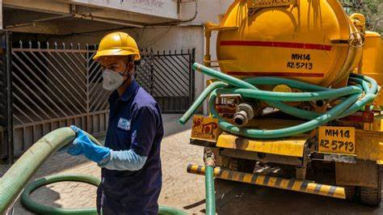
PROTECTION OF SANITATION WORKERS
The Water Services Institution must:
  Ensure sanitation workers ‘safety through the provision of personal protective equipment, vaccination and deworming against disease relevant to their working environment.
  Ensure workers are trained on the risks of handling faecal sludge and on standard operating procedures.
  Ensure safety of workers through the provision of facilities to wash with water and soap.
  WRC developed guidelines to assist the sector to protect sanitation workers.

Slide 14
CONCLUSION
AMPS is encouraged to familiarise themselves with the Norms and Standards and prepare for compliance and National Feacal Sludge Management Strategy.
Meeting and achieving the SDG 6.2 would require collaboration and efforts of all stakeholders.

Slide 15

SANITATION IS DIGNITY
Thank you
Re a leboga

